Slide 1
Electronic Workshop - 2
Audio Amplifier
TEAM - 24
Salay Jain (20171078)
Aradhya Tongia (20171049)

Slide 2
Block Diagram
MIC
PRE-
AMPLIFIER
GAIN
POWER
AMPLIFIER
LOAD
FILTER

Slide 3
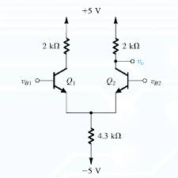
Preamplifier
An audio preamplifier is designed in a way to amplify very weak signals before feeding them to further gain stages and to cancel the irrelevant noise.
To achieve this, we will be using bjt based differential amplifiers as it can be used to cancel the common noise which is coming, as well as it can amplify the weak signals a bit so that it can be sent to next stage for getting a better gain.

Slide 4
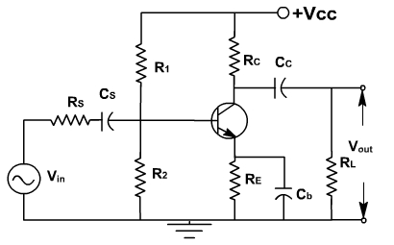
Gain stage
In this stage our motive will be to get as much voltage gain as possible.
In this stage, we will amplify the weak signals in a considerable amount to get a large gain, so that it becomes a strong signal which may not attenuate easily.
So we use common emitter amplifier here which can amplify the weak signals with a huge gain.

Slide 5
Filters
An audio filter circuit consists of a bandpass filter for the audio frequency band, and it filters the unwanted noise signals.
We use an active filter instead of a passive filter because an active amplifier has a high input impedance due to which our signal can not be destroyed.
Using an active amplifier gives us the flexibility of choosing different values for gain and other specifications using different op-amps.
Also passive filters consume the energy of the signal without giving any power gain, but in the case of active filters, we get a power gain.

Slide 6
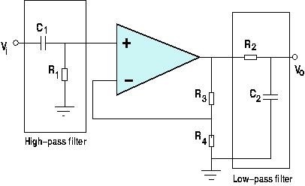
We can use a high pass filter in combination with a low pass filter to make a bandpass filter.

Slide 7
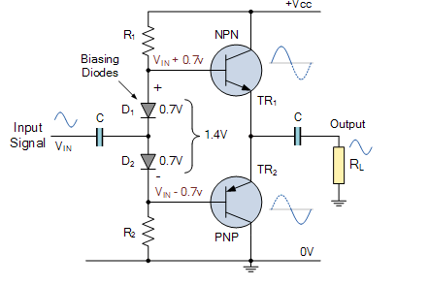
Power amplifiers
A power amplifier is designed to increase the power of a signal which should be sufficient enough to drive loads .
As we have been amplifying voltage till now but as load is of 8ohm only so collector current will not provide the high load current leading to loading effect . Thus we use Power amplifier.
We are using AB type power amplifier to get distortion free as A type and high efficiency as B type . Also we use BJT instead of resistor to reduce power and for temperature ineffective.

Slide 8
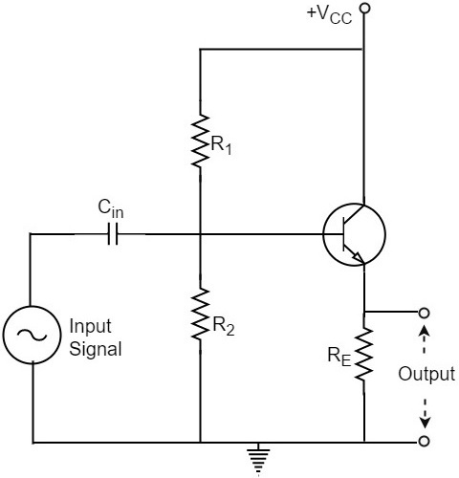
Buffers
A buffer is used to transfer some voltage/current from one stage in a circuit to another stage.
We are using voltage buffers here so that our audio signal is not affected by whatever current the load delivers, i.e. Loading effect.
Also we use the unity gain voltage buffer, so that whatever signal is being produced by the previous stage is fully gained by the next stage.
This can be achieved with the help of common collector amplifier as its voltage gain is nearly 1.
So, we can use this buffer between every 2 stages of our circuit.

Slide 9
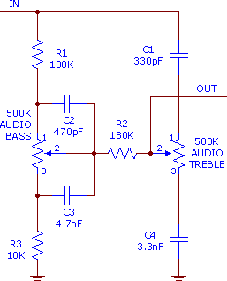
Bass and Treble control
The bass and treble settings can help in controlling the lower and higher frequency sounds in the music that is being played through the speakers.
Bass and treble implement a first order response and provide an adjustable boost or cut to frequencies above or lower than a certain point.
We are using passive devices to control the bass and treble of the audio, because it makes a much smoother cut and boost to it.

Slide 10
END OF PRESENTATION
THANK YOU

